Slide 1


Slide 2
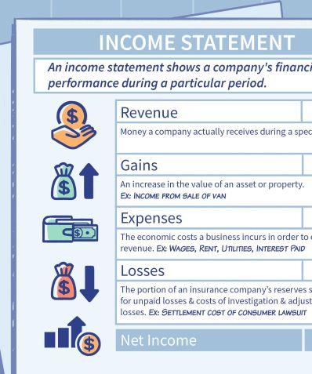
Lecture 7
Statement of
Profit & Loss

Slide 3
Learning Outcomes:
Upon successful completion of session, students will be able to…
Explain the purpose of Income Statement;
Draft a simple Statement of Financial Performance;
Explain how and why revenue and expenses are disclosed in income statement.

Slide 4
Overview of Previous Sessions
T-accounts
Trial Balance
P&L account
Balance sheet
Bank ledger account Debit Credit
20.01.20 |  | $16,550 | 24.01.20 |  | $1,000
 |  |  | 26.01.20 |  | $2,000
 |  |  | 31.01.20 | balance c/d | $13,550
 |  | $16,550 |  |  | $16,550
01.02.20 | balance b/d | $13,550

Slide 5
Overview
T-accounts
Trial Balance
P&L account
Balance sheet
Trial Balance
Name of Accounts | Debit | Credit
Bank (Assets) | 13,550
Cash (Assets) | 5,550
Equipment (Assets) | 8,000
Office Supplies (Assets) | 500
Artsy Co (Assets) | 3,000
Capital (Capital) |  | 25,000
Sales (Revenues) |  | 9,000
Discount received (Contra expense) |  | 50
Rent expenses (Expenses) | 1,200
Salary expenses (Expenses) | 2,000
Utilities expenses (Expenses) | 250
Total | 34,050 | 34,050

Slide 6
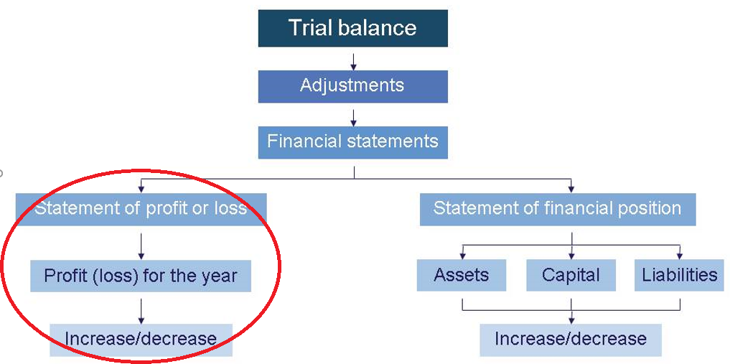
From Trial Balance to Financial
Statements

Slide 7
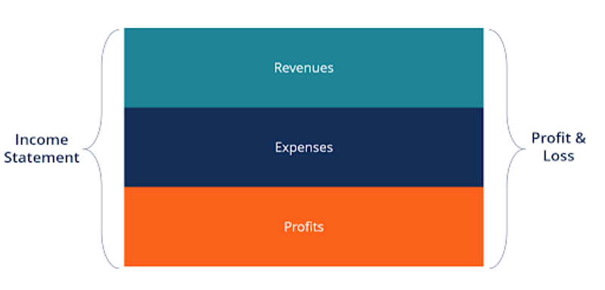
Statement of Profit & Loss
is one of a company’s core financial statements that shows their profit and loss over a period of time. The profit or loss is determined by taking all revenues and subtracting all expenses from both operating and non-operating activities.

Slide 8
Statement of Profit & Loss
A record of income generated and expenditure incurred over a given period
Revenue is the income generated by the operations of a business for a period.
Expenses are the costs of running the business for the same period.
Revenue > Expenses = Net Income
Revenue < Expenses = Net Loss

Slide 9
What is included as Revenue?
Turnover (sales)
Gains on sale of fixed assets
Interest receivable
Investment income
Discounts received
Share of profit from associated companies

Slide 10
What is included as Expenses?
Cost of Sales (COGS)
Depreciation
Losses from the sale of fixed assets
Discounts allowed
Increase in provision

Slide 11
Income Statement by nature
 | Note | NZ$
Revenue | 1 | xx
Other Income | 2 | xx
List of all… |  | xx
…expenses… |  | xx
…by nature |  | xx
(totals for each type of expense) |  | xx
Operating profit before interest and tax | 3 | xx

Slide 12
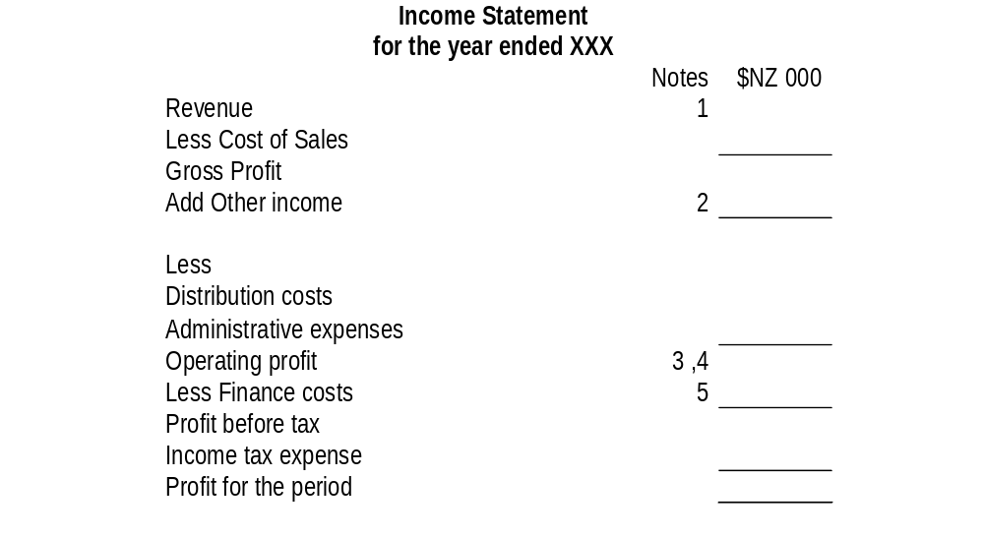
Example of an Income Statement prepared according to the “Function “ classification

Slide 13
Distribution expenses
Include all costs of holding goods for sale, promotional, advertising and selling costs and costs of transferring goods to customers.
Sales staff salaries, commissions and bonuses and related employment costs;
Advertising and promotion costs;
Warehouse costs;
Transportation costs (including depreciation on vehicles);
Sales outlet costs (including depreciation and maintenance costs)

Slide 14
Administrative expenses
Include operational costs other than those associated with the production and distribution of goods and services.
Administrative staff salaries, bonuses and related employment costs, also included are directors’ executive salaries and related employment costs;
Administration building costs (including depreciation and maintenance);
Professional fees;
Amounts written off in respect of bad debts

Slide 15
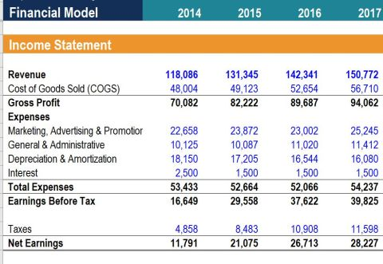
Statement of Profit & Loss

Slide 16
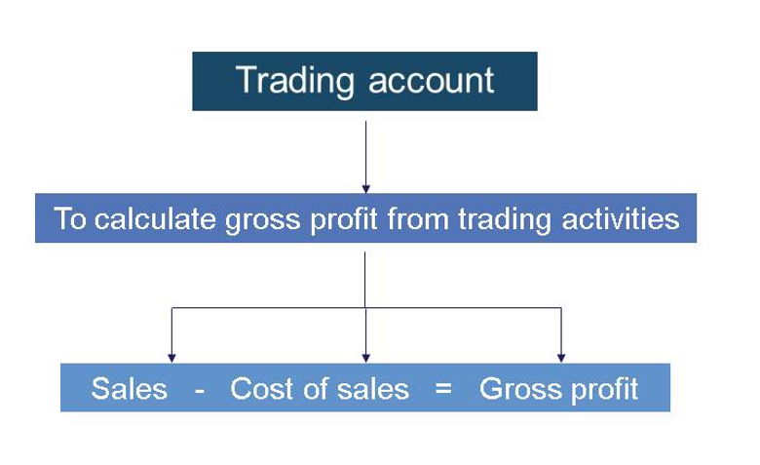
Preparation of Income Statement
Trading account section – to calculate the gross profit (excess of sales over the cost of goods sold).

Slide 17
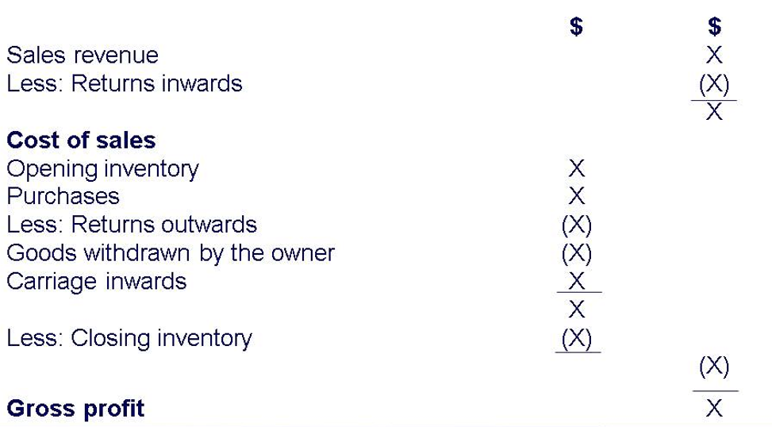
Step 1. Trading Account

Slide 18
Step 2. Net Profit Calculation
Helps to calculate the net profit (excess of gross profit and other revenues over all other expenses)
Wages and salaries
Advertising and sales promotion
Depreciation
Bad debts
Provision for bad and doubtful debts (increase/decrease)
Discounts allowed
Directors’ remuneration
OPERATING PROFIT
Dividends receivable..
Income from other fixed assets investments **
PROFIT BEFORE INTEREST AND TAX (PBIT/ EBIT)
Debenture Interest
Loan interest
PROFIT BEFORE TAX (PBT)
Taxation …
PROFIT AFTER TAX (PAT)

Slide 19
Step 3. Profit or Loss Appropriations
It shows how the net profits are to be appropriated, used or distributed.
Dividends paid:
On ordinary shares
On Preference shares
Transfer to various reserves
Retained profits for the year
Add Retained profit from previous year b/f
Retained profit c/f

Slide 20
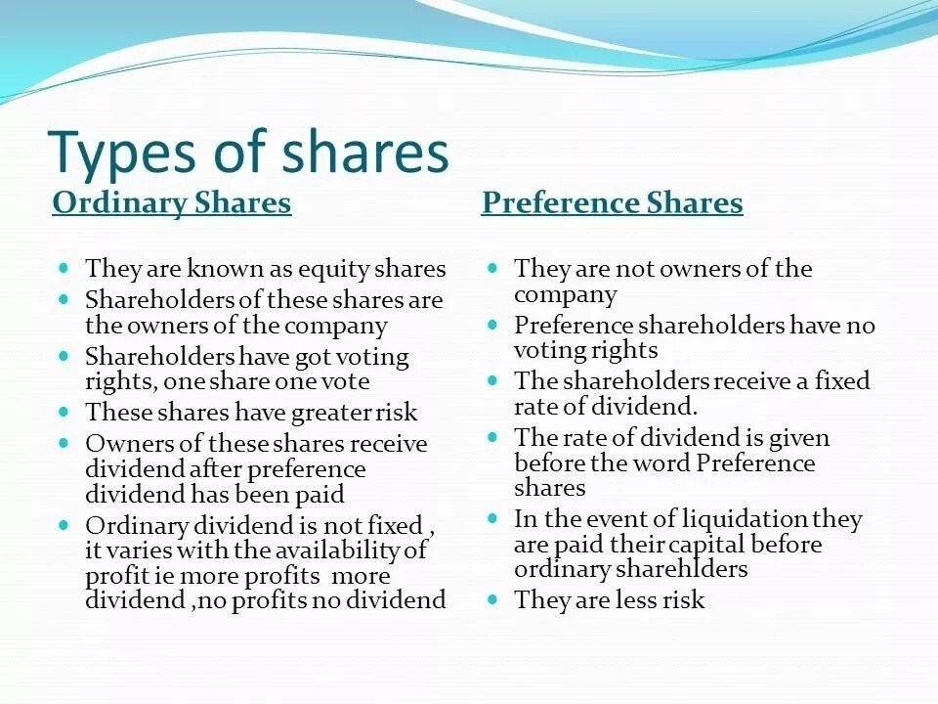

Slide 21
Debenture is a long-term debt instrument used by large companies to borrow money, at a fixed rate of interest. The legal term "debenture" originally referred to a document that either creates a debt or acknowledges it.
A debenture is thus like a certificate of loan or a loan bond evidencing the fact that the company is liable to pay a specified amount with interest.

Slide 22
Business Entity Concept
The business entity concept states that financial accounting information relates only to the activities of the business entity and not to the activities of its owner.
The business entity is treated as separate from its owners.

Slide 23
Matching Convention
The income statement is prepared following the accruals concept. This means that income and expenses are recorded in the income statement as they are earned/incurred regardless of whether cash has been received/paid.
The sales revenue shows the income from goods sold in the year, regardless of whether those goods have been paid for.
The cost of buying the goods sold must be deducted from the revenue.
It is important that the cost of any goods remaining unsold is not included here.

Slide 24
Lecture Roundup:
There are some important differences between the accounts of a limited liability company and those of sole traders or partnerships.
In preparing a statement of financial performance, a student must be able to deal with:
Trading account
Net Profit Calculation
Profit or Loss Appropriations
Various types of revenues and expenses that are disclosed in income statement

Slide 25
References:
ACCA (2017) Approved Interactive Text. Foundations in Accountancy FFA 2017/2018. BPP Media Ltd, Chapter 18, 19 & 20
Perks, R (2004) Financial Accounting for Non-specialists, chapters: 1,2, 10,11
Dyson, J.R (2004) Accounting for Non-Accounting Students, chapter 4,6
Wood F & Sangster A, Business Accounting 1, chapters 7,8, 9, 45
Glautier, M & Underdown B (2001) Accounting Theory and Practice, 7th edition, chapter 11,14.
Weetman, P. (1996) Financial Accounting, an Introduction, Pitman Publishing, chapters 8, 9, 10, 11.
Britton, A. & Waterson, C. (2003) Financial Accounting, Pearson Education Limited, third edition, chapters 2, 7.
Pendlebury, M. & Groves, R. (2001) Company Accounts: Analysis, Interpretation and understanding, 5th edition, Thomson publishing, chapter 2.

